Slide 1
Take Grant System

Slide 2
Take Grant Graph Model
Jones et al – Capability system (Hydra )
Nodes of the Graph : Subjects and objects
subjects are not objects in this model
Edges: rights
two special rights: take ( t), and grant (g).
If a subject s has “t” for an object x, then it can take any of x's rights;
if it has “g” for x, then it can share any of its rights with x.

Slide 3
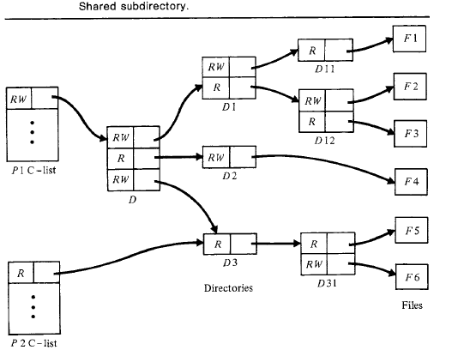

Slide 4
P1 with an R W-capability for the root D of a file directory. To read F1, P1 would first get the R W-capability for directory D1 from D; it would then get the R W-capability for D ll from D1, and finally get an R-capability for F1 from D11.
Similarly,others
Process P1 can share D3 with a P2 by giving it an R-capability for subdirectory D3;
Thus P2 can only access files F5 and F6; it cannot modify any of the directories.

Slide 5
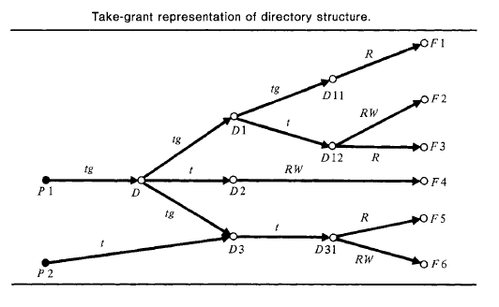
O – Objects; Black bullets: Subjects

Slide 6
Take Grant Model
The take-grant model describes the transfer of authority (rights) in systems.
It does not describe the protection state with respect to rights that cannot be transferred.
Thus, it abstracts from the complete state only information needed to answer questions related to safety.

Slide 7
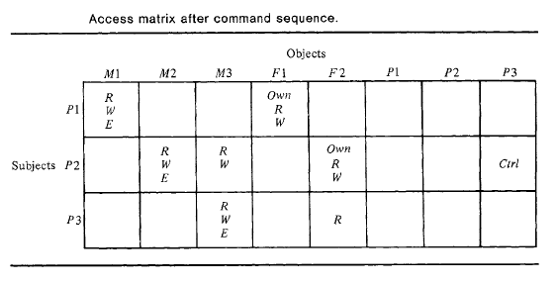
Note: Process p is given the Ctrl right to q, allowing it to take or revoke any of q's
rights, including those conferred on q by other processes.

Slide 8
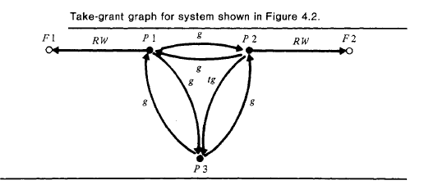

Slide 9
A process can grant rights for any of its owned files to any other process, so there is an edge labeled g connecting each pair of processes.
Only process P2 is allowed to take rights from another process, namely its subordinate P3, so there is only one edge labeled t.

Slide 10
Because rights for memory segments cannot be granted along the g-edges (memory is not owned and the copy flag is not set), these rights are not shown.
Consequently, the graph does not show P2 can take P3's rights for memory segment M3 (as it did).

Slide 11
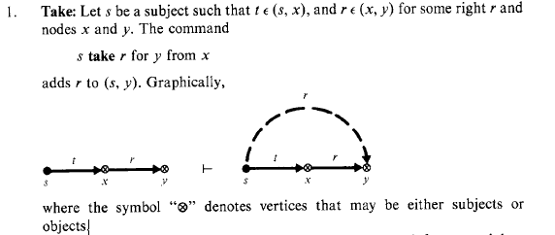
Graph Rewrite Rules (1)

Slide 12
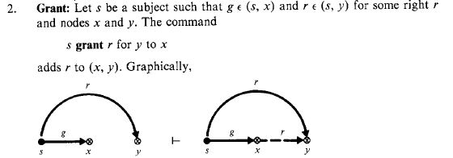
Graph Rewrite Rules (2)

Slide 13
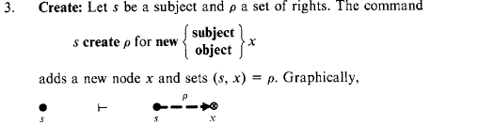
Graph Rewrite Rules (3)

Slide 14
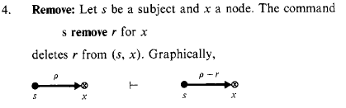
Graph Rewrite Rules (4)

Slide 15
Example
process P1 can create a new file F7 and add it to the directory D11
P1 create RW for new object F7
P1 take t for D1 from D
P1 take g for D11 from D1
P1 grant R W for F7 to D11

Slide 16
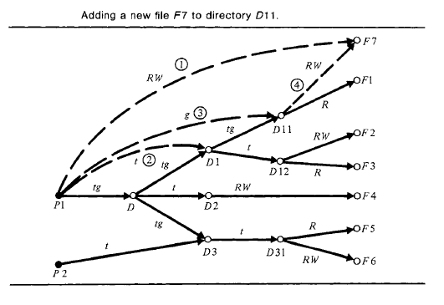

Slide 17
Safety in Protection Graph
G : a protection graph.
G |-- G' if command c transforms G into graph G',
G |--c G' if there exists some command c such that G |--c G', and
G |--* G' if there exists a (possibility null) sequence of commands that transforms G into G'.

Slide 18
Safety in Protection Graph
Consider a node s with right r for node x; thus r in (s, x).
Safety question: Determine whether another subject can acquire right r (not necessarily for x).
Rather than consider whether an arbitrary subject can acquire the right r for an arbitrary node, consider whether a particular node p (subject or object) can acquire the particular right r for x.
If this is decidable, so is the general question

Slide 19
Safety
Given an initial graph Go with nodes s, x, & p such that r in (s, x) and r not-in (p, x), Go is safe for the right r for x
if and only if r not-in (p, x) in every graph G derivable from Go (i.e., Go |--* G).
Proof in two parts:
s can "share" its right with other nodes (but not necessarily p)
the right must be "stolen" from s.

Slide 20
Proof
Go with nodes p & x s.t. r not-in(p, x) in Go
predicate can.share(r, x, p, Go) is true iff there exists a node s in Go such that r in (s, x) &
Go is unsafe for the right r for x; that is, p can acquire the right r for x.
Rights can only be transferred along edges labeled either t or g.
Nodes x and y are tg-connected if there is a path between them s.t. each edge on the path is labeled with either t or g (direction is not important);
Directly tg-connected if the path is just (x, y) or (y, x).

Slide 21
Proof of canshare
Theorem1:
can.share(r, x, p Go) is true if p is a subject and
There exists a subject s in Go such that r in (s, x) in Go, and
s and p are directly tg-connected.

Slide 22
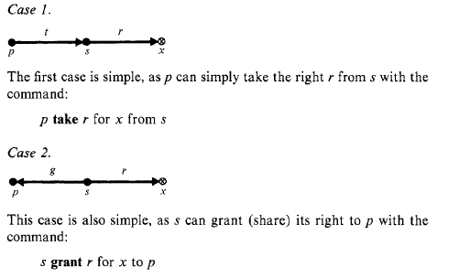
Proof of canshare - Theorem

Slide 23
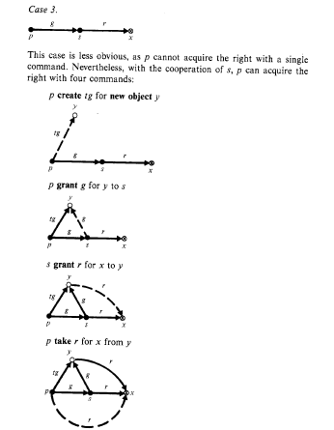

Slide 24
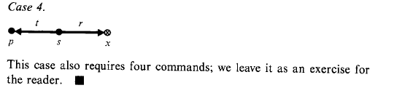

Slide 25
This result is easily extended to handle the case where subjects s and p are tg-connected by a path of length >=1 consisting of subjects only.
Letting p = P0, P1 . . , pn= s denote the path between p and s, each p can acquire the right from Pi+l as described in Thm 1.
It turns out that tg-connectivity is also a necessary condition for can.share in graphs containing only subjects
Theorem 2 :
If Go is a subject-only graph,
then can.share(r, x, p, Go) is true if f:
a. There exists a subject s in Go such that r in (s, x), and
b. s is tg-connected to p.

Slide 26
Graph Contains both Subjects and Objects

Slide 27
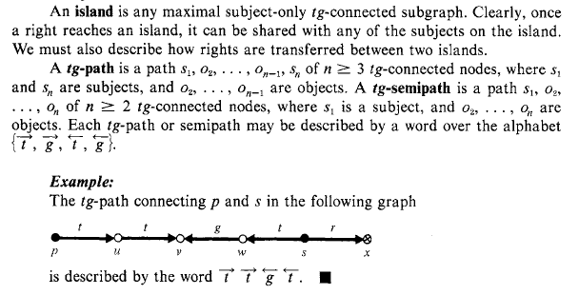

Slide 28


How s can share its right r for x with p ?

Slide 29
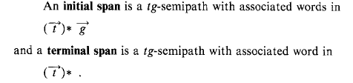
Arrows emanate from the subject sl in the semipaths.
Note that a bridge is a composition of initial and terminal spans.
The idea is that a subject on one island, is responsible for transferring a right over the initial span of a bridge, and
a subject on the other island is responsible for transferring the right over the terminal span;
the middle of the bridge represents a node across which neither subject alone can transfer rights.

Slide 30
Main Theorem
Thm 3: Predicate can.share(r, x, p, Go) is true if and only if:
There exists a node s such that r in (s, x) in Go; and There exist subjects p' and s' such that
p' = p (if p is a subject) or p' is tg-connected to p by an initial span (if p is an object), and
s' = s (if s is a subject) or s' is tg-connected to s by a terminal span (if s is an object); and
There exist islands I1 . . . , Iu (u > =1) such that p' in I1, s’ in I,, and there is a bridge from Ij to Ij+l
(1<= j < u)

Slide 31
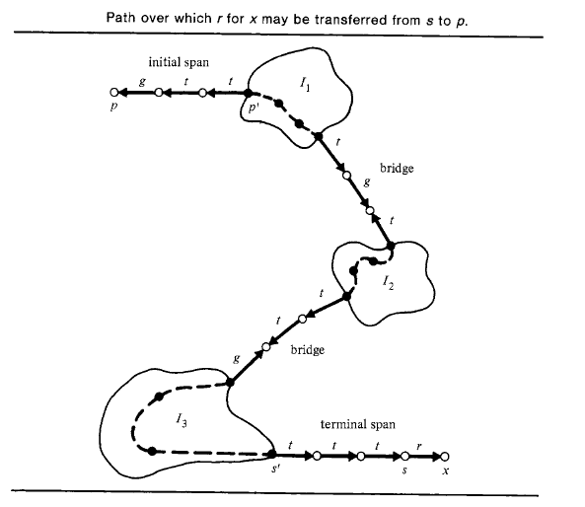
initial span is used only
when p is an object;
A terminal span is
similarly used only
when s is an object

Slide 32
Algorithm
There is an algorithm for testing can.share that operates in linear time in the size of the initial graph,

Slide 33
Stealing
A node p steals a right r for x from an owner , s if it acquires r for x without the explicit cooperation of s.
I.e., can.steal(r, x, p, Go) is true iff p does not have r for x in Go and there exist graphs G1, . . . , Gn, such that:
1. Go I—c1 G1 I—c2 . . . L--cn Gn;
2. r in (p, x) in Gn; and
3. For any subject s such that r in (s, x) in Go, no command ci is of the form
s grant r for x to y
for any node y in Gi-1.

Slide 34
Theorem
Theorem 4: can.steal(r, x, p, Go) is true iff
1. There is a subject p' such that p' = p (if p is a subject) or p' initially spans to p (if p is an object), and
2. There is a node s such that r in (s, x) in Go and can.share(t, s, p', Go) is true; i.e., p' can acquire the right to take from s.
I.e., if a subject cannot acquire the right to take from s, then it cannot steal a right from s by some other means.
Stealing Subjects are called conspirators.

Slide 35
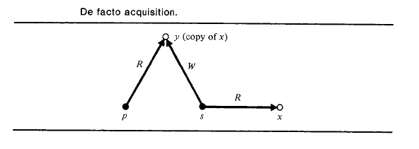
If a subject cannot steal a right for an object x, this does not
Necessarily mean the information in x is protected
Eg, Another subject s may copy the information
in x into another object y that p can read

Slide 37
T-G System
it does describe many aspects of existing systems, especially capability systems.
Nevertheless, the results are significant because they show that in properly constrained systems, safety decisions are not only possible but relatively simple.
Safety is undecidable in HRU because the commands of a system were unconstrained;
a command could, if desired, grant some right r for x to every subject in the system.
The take-grant model, on the other hand, constrains commands to pass rights only along tg-paths.

Slide 38
Access Matrix
Vs
Take Grant

Slide 39
Properties that can be Analysed by ACM but not by T-G
The strength of the Access Control Matrix Model – flexibility.
Unlike the TG, no condition on the types of rights or their flow between subjects & objects, & hence can model a wider variety of protection systems.
Consequences of destruction of entire objects can be studied only in ACM, since TG does not permit the operations
TG: is not expressive enough to study change in protection state over parameters such as time of the day and role of the subject

Slide 40
Properties that can be Analysed by TG but not by ACM
Is the ability to analyse the safety of a protection system in time linear with the number of subjects and objects in the system.
In case system safety is compromised wrt right r, TG allows us to analyse all possible subjects that needto be involved in order to leak it.
even possible to analyse whether a theft of that is possible by a subject without needing coop.of other subject
Enable us to quantify the amount of trust that the system would be placing on different subjects.

